Slide 1
UseRef Hook

Slide 2
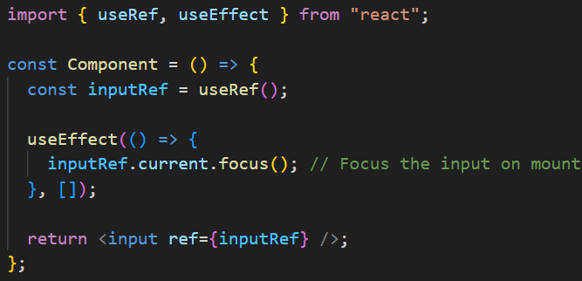
Accessing a DOM Node
You can use useRef to get a reference to a DOM node — like a div, input, etc.

Slide 3

Where to Access DOM Node Using useRef
Access dom node using useRef Inside useEffect() — this ensures that the DOM is fully mounted before you try to access it.
Avoid accessing ref.current during render. This won’t work reliably because the DOM node isn’t attached yet (it will be attached after mounting has been completed):
A DOM node can also be accessed inside an event handler using useRef.

Slide 4
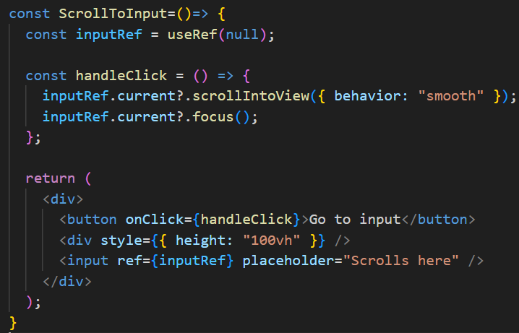
Where to Access DOM Node Using useRef
By the time an event handler (like a button click) runs, the component has already been mounted, and the DOM is available. So ref.current will point to the DOM element.

Slide 5
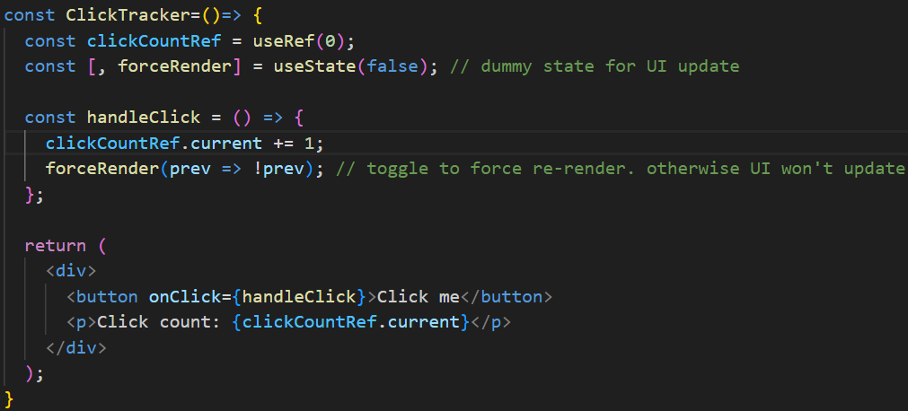
Persisting Values Across Re-renders Using useRef
The useRef hook can also be used to store a value that persists across re-renders.
However, updating the value of a ref does not trigger a component re-render, unlike updating state with useState.

